Slide 1

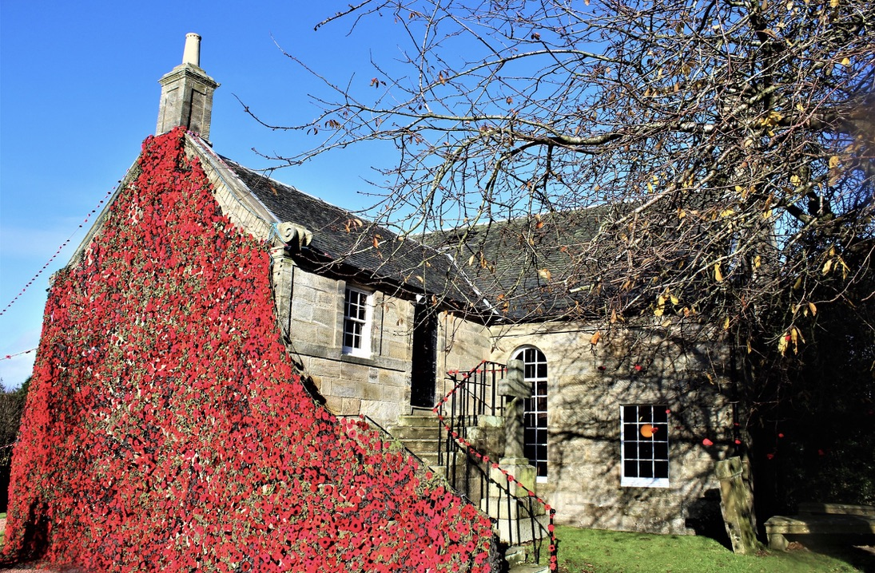
The Carmunnock Experience
A Community Survey
Conducted by the Carmunnock Community Forum, May 2024

Slide 2
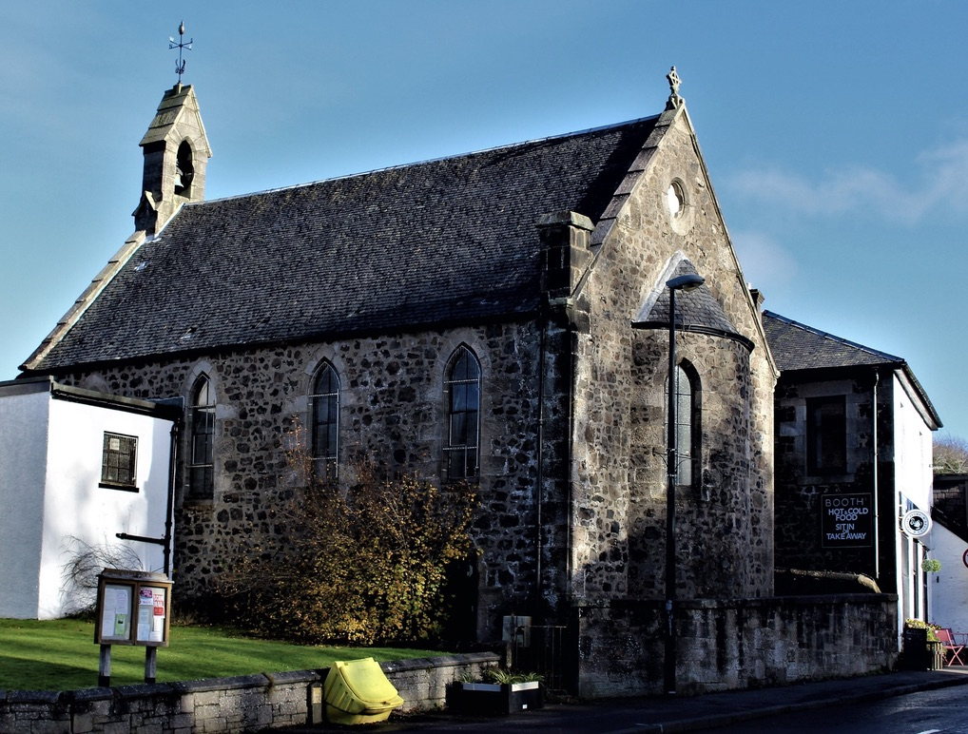
Content
Respondents
Questions
Involvement
Village Places and Spaces
Methods of Communication
Village Priorities
Discussion
“Thank you very much for organising this survey. I can only imagine the amount of work that’s gone into this. It’s let me have my say on a few things and that is much appreciated. Thanks you again”

Slide 3
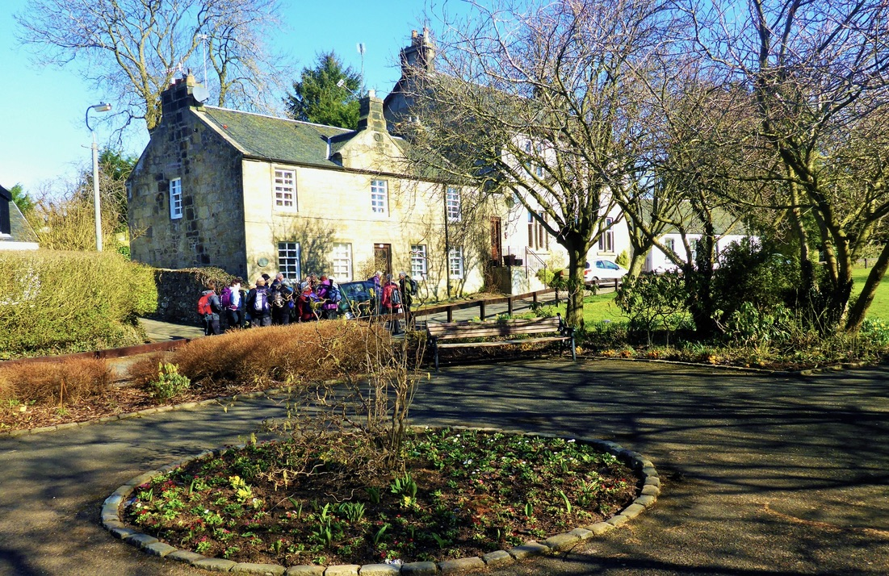
Respondents
Two modes of accessibility: Electronic and Hard Copy
(Facebook pages, carmunnock.org, door drops and Booths)
201/1880 (550 Households)
10% people, almost 40% Households
43% increase since 2020
90% identified as 35 and above,
34% 65 plus
56% 35-64
10% 43 and below
2 people were below 18
Majority identified as White, Caucasian, Scottish/British
55% 10 years plus v 45% 9 years and less

Slide 4
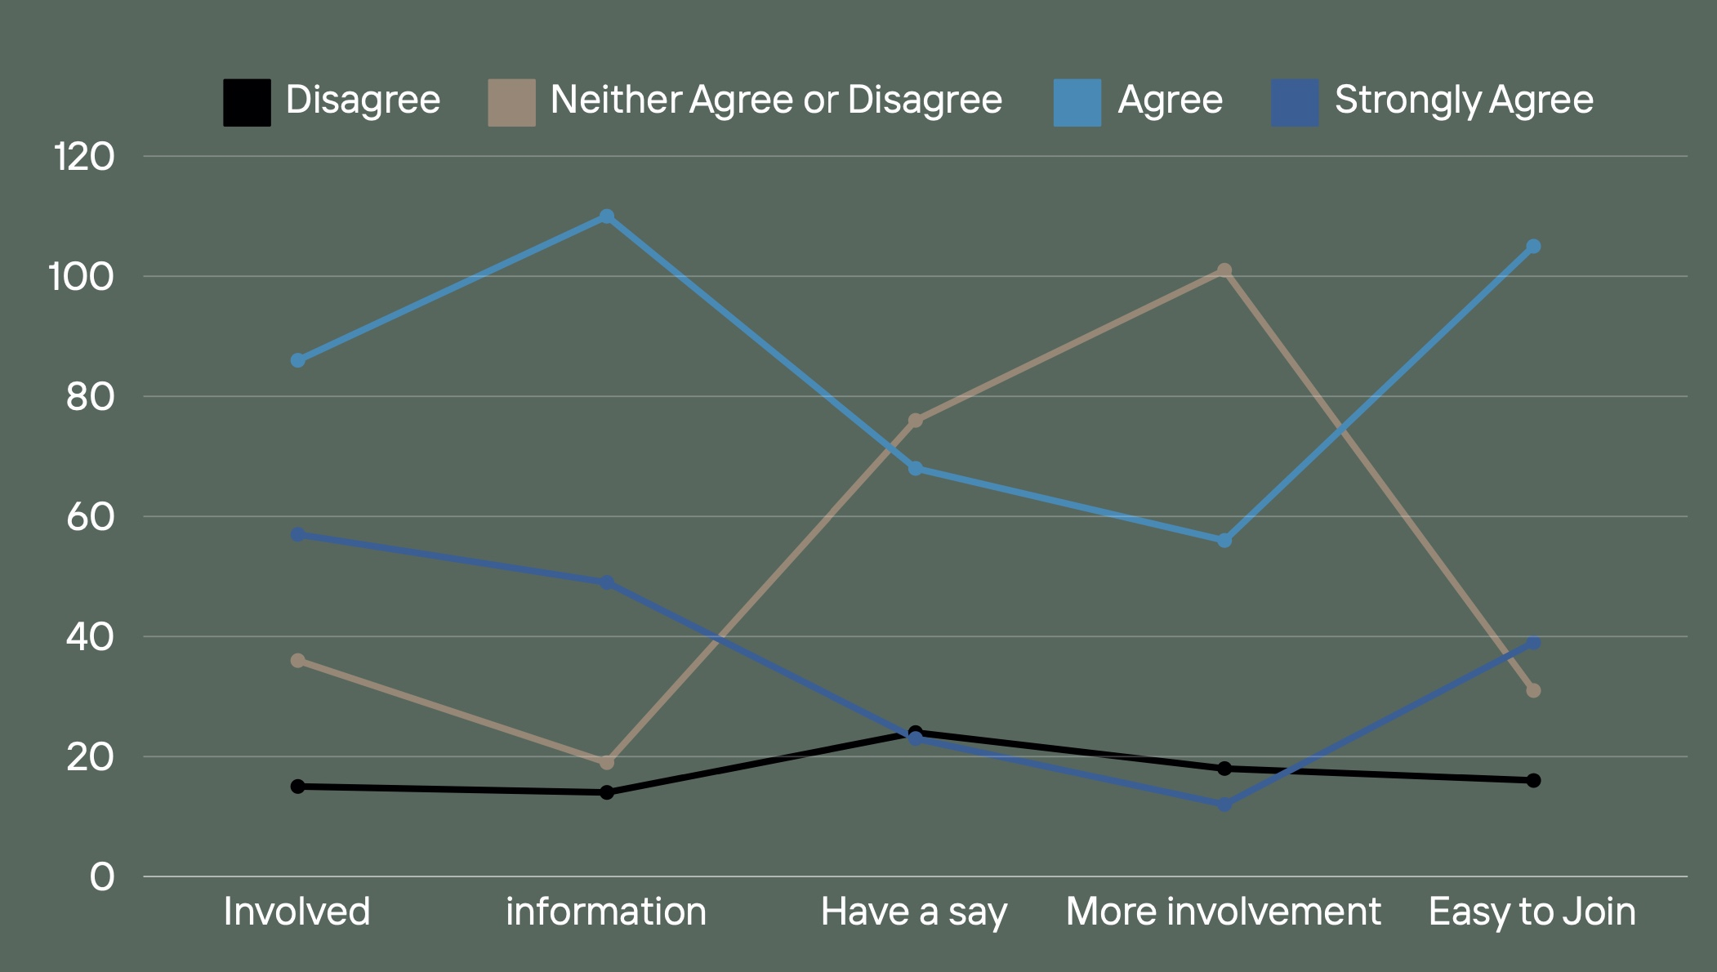
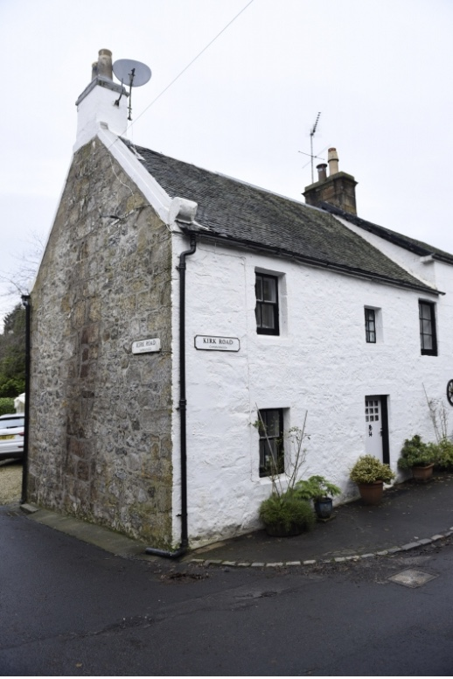
Involvement
Felt Involved
71% Agree, 17% neutral, 8% Disagree
Easy to get information
80% Agree, 9% Neutral, 7% Disagree
Have a say
45% Agree, 38% Neutral, 12% Disagree
More Involvement
36% Agree, 50% Neutral, 9% Disagree
Easy to Join
72% Agree, 15% Neutral, 8% Agree
2020 Happy with levels of Involvement
Easy to get information and welcoming
36% like more involvement but time, kids, work commitments
Having a say might be an area to work on?
“I’m involved enough to make me feel part of village life”

Slide 5
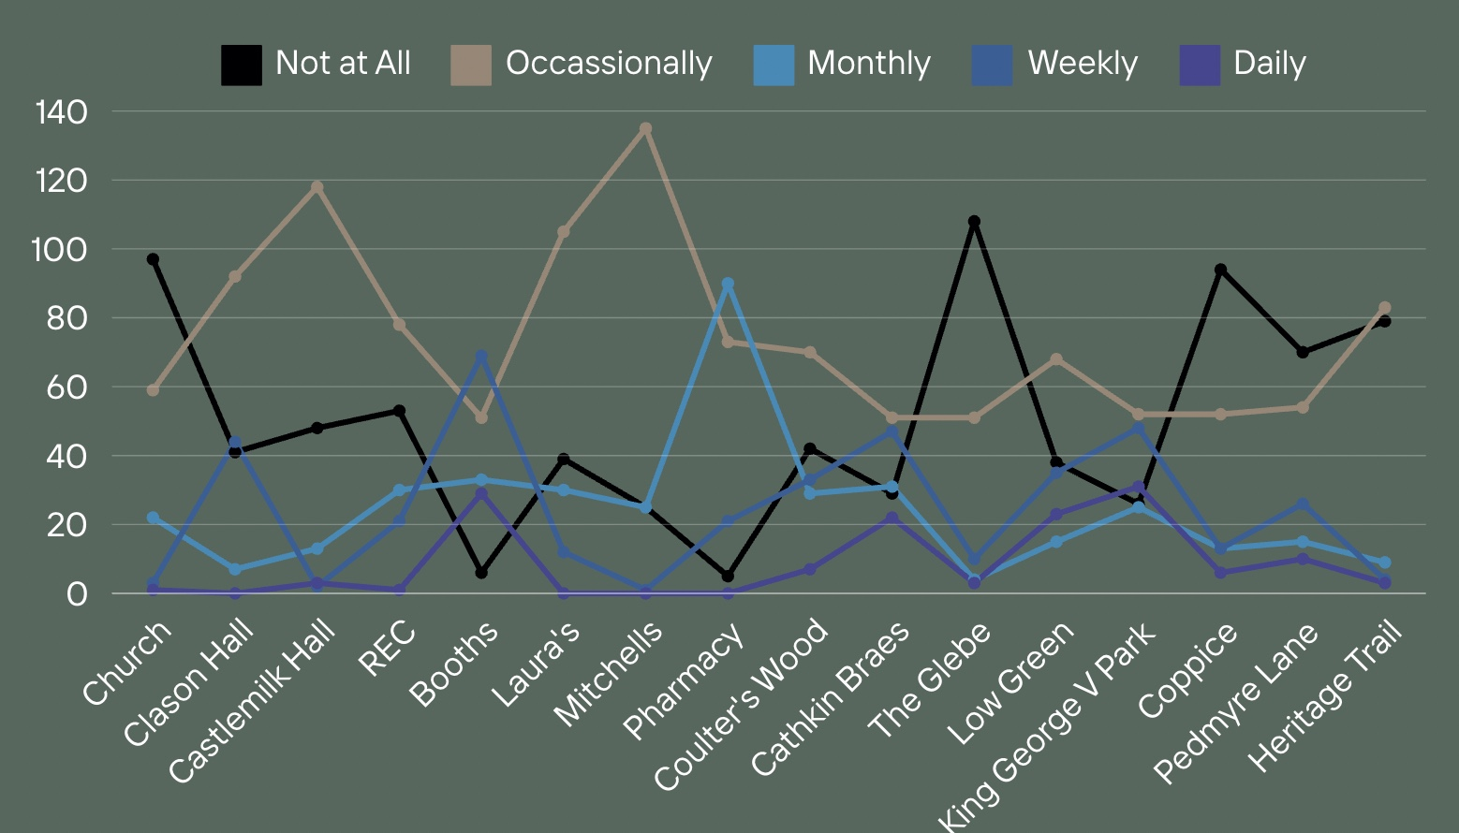
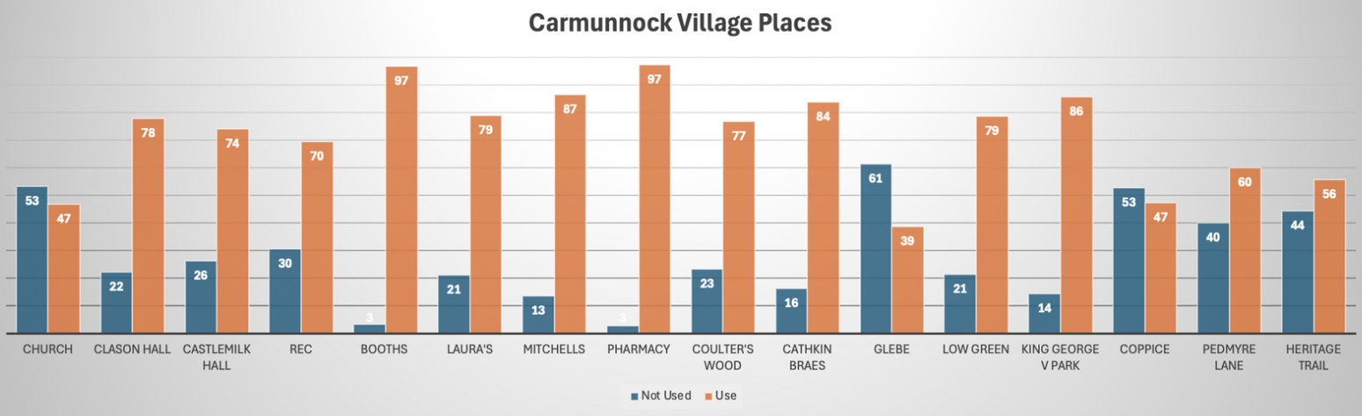
Places & Spaces
When asked about level of usage – Occassionally is the more given answer to all
High level of places not been used
Our village businesses as the places most used and most frequently
Our outdoor spaces and our church are the least used
Community Buildings
Refurbishment/better standards was the biggest area of feedback
Welcoming Atmosphere
Environment
Accessibility
Comfort
Public Transport
Parking
“A plan for development and maintenance for all older buildings would help fundraising effort and attract wider support ”

Slide 6
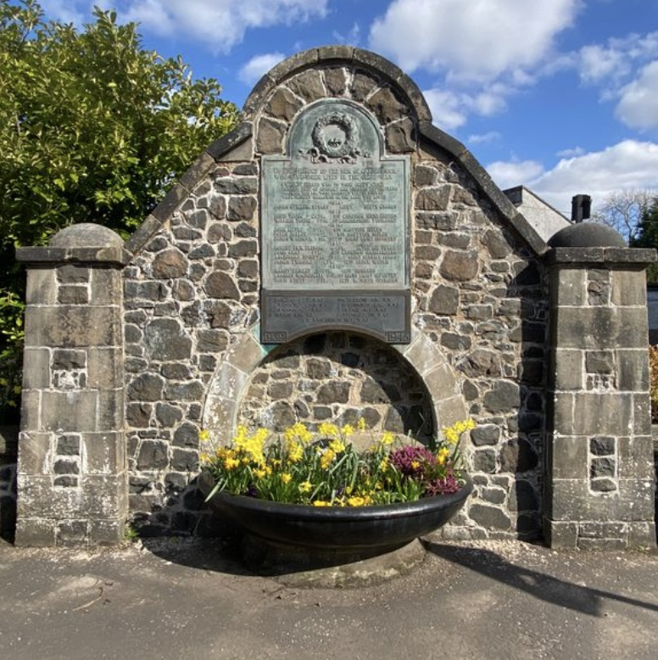
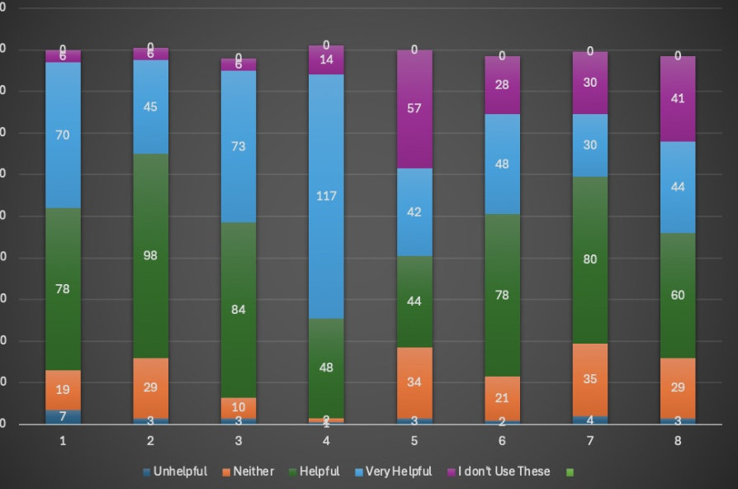
Methods of Communication
165 Facebook Pages (Carmunnock)
Word of Mouth
Posters and Letter drops have increased
CCC Newsletter, Covenanter and Noticeboard have decreased
carmunnock.org has been positively received
Improvement Suggestions
Variety to meet diverse needs
Up to date
QR Codes linked to FB and carmunnock.org
Calendar of events
Reinstate ‘Welcome Packs’
“Variety is key”

Slide 7
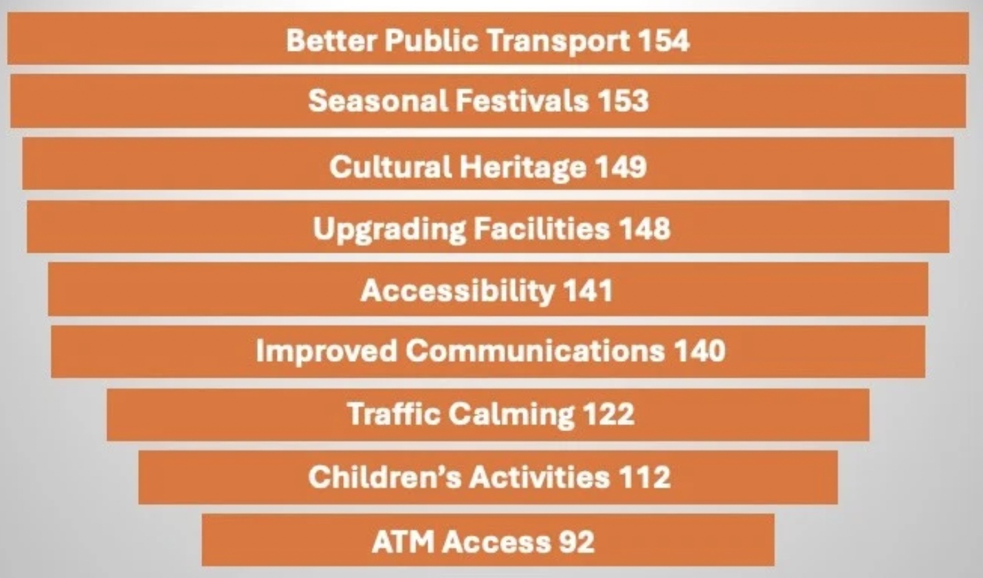
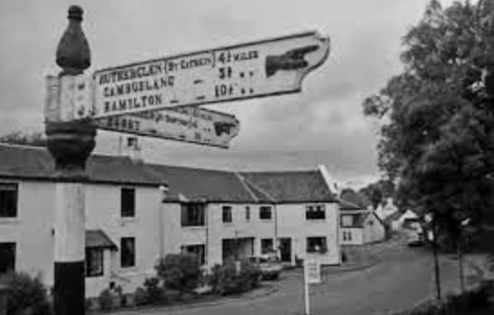
Village Priorities
Findings similar to 2020
Accessibility and Traffic Calming have decreased
Seasonal Festivals, Cultural Heritage, Upgrading facilities have been added
Better Public Transport – Bus Links to City Centre and Glasgow Hospitals
Traffic calming, Children’s Activities and ATM
“Number 75 bus picking up and dropping off passengers in Carmunnock before going back down to wait at the Castlemilk terminus”

Slide 8
Discussion and Possible Next Steps
People feel involved in village life and are happy with their levels of involvement
Barriers to getting more involved are: busy lives re children, work or other commitments. Being new.
Easy to get information (particularly Facebook, word of mouth, posters and door drops)
Carmunnock.org is great but needs to continue to evolve, have everything in there and be up to date
People would like more of a say in decision making
Better communication (flexibility is key)
Businesses, church and outdoor spaces could be better utilised
Refurbishment, comfort, welcoming atmosphere and accessibility is a top priority for people when it comes to utilising our buildings. Comfort and Welcoming atmosphere and Accessibility
Better bus links is out top priority, followed by continuing to evolve our seasonal festivals, protect our cultural heritage, upgrade our facilities, provide accessibility and improve communication
Next Steps
Report
Spot research to measure the strength of feeling of issues such as; having a say, communication etc
Rephrase the questions in next survey – start with the end in mind
“what do we want to know more about?”
Strategic Plan by CCF

